Slide 1
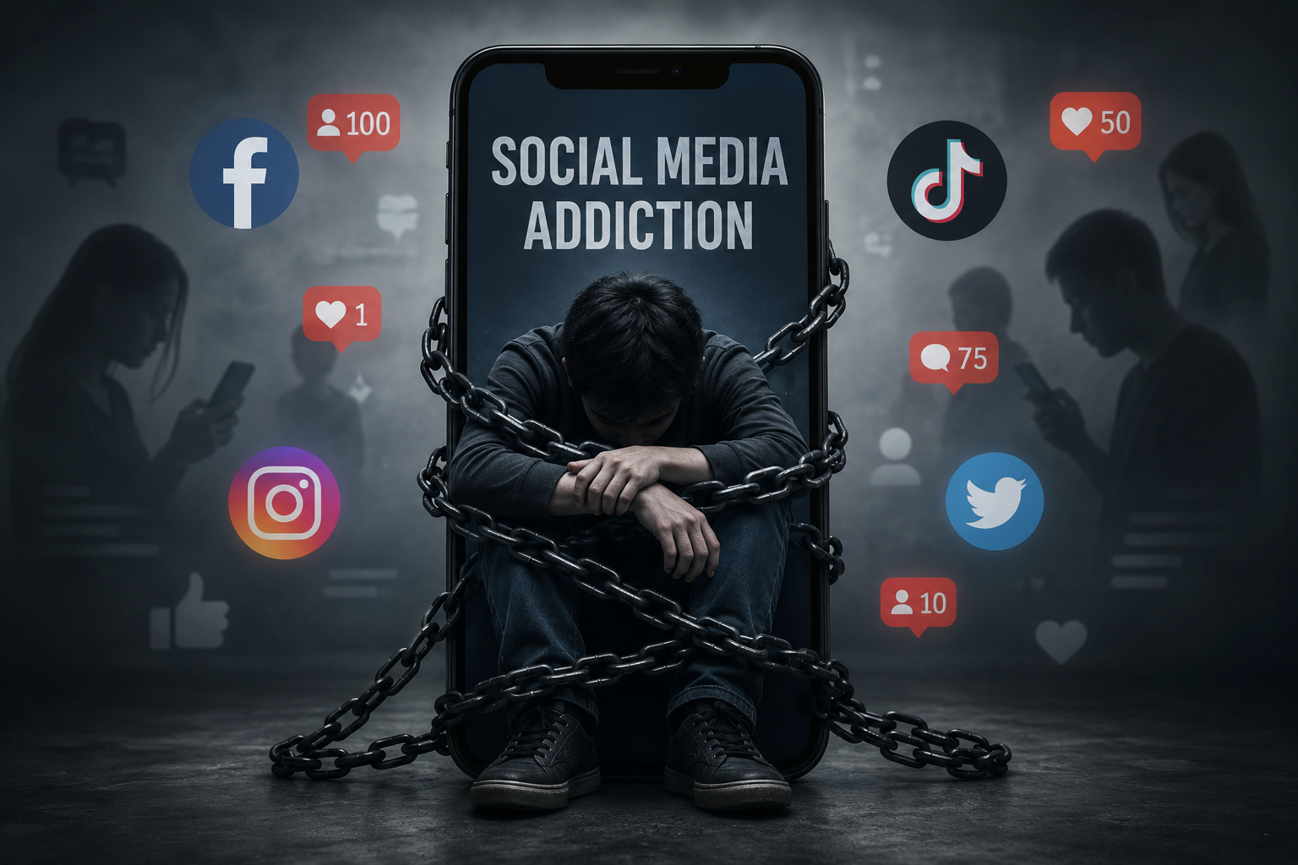


SOCIAL MEDIA ADDICTION ANALYTICS
Behavior • Mental Health • Productivity
“Turning behavioral data into actionable insights.”

Slide 2



Our Analytics Journey
Team
📱 The problem
📊 Under Standing the Data
🧠 Behavioral Analytics
🔥 Key Insights
✅ Recommendations

Slide 3
Our Analytics Journey
Team
📱 The problem
Why social media addiction matters
📊 Under Standing the Data
Dataset • Preprocessing • Modeling
🧠 Behavioral Analytics
Usage • Mental Health • Productivity
🔥 Key Insights
Addiction patterns • High-risk users
✅ Recommendations
Actions • Future improvements

Slide 4

Team Members:
1- Ramez Gamal.
2- Asmaa Elazab.
3- Zeinab Ibrahim.
4- Amr Mansour.
5- Mostafa.

Slide 5
📱 The problem
“Social Media Is Changing Human Behavior”
Excessive social media usage is no longer just a digital habit — it has become a behavioral, mental, and productivity challenge.
Users today spend several hours daily scrolling through social platforms, leading to:
Increased addiction behavior
Higher stress and anxiety levels
Sleep disruption and lifestyle imbalance
Reduced focus and productivity
Emotional dependency on online interactions
.

Slide 6

📱 The Project Objective
This project explores how excessive social media usage affects:
User behavior
Mental health
Productivity
Lifestyle balance
Using:
Python (Pandas) • Power BI • Data Analytics
We transformed raw behavioral data into actionable insights.
The key analysis focuses on identifying:
Social media addiction patterns
Behavioral trends
Mental health risks
Productivity impact
Future predictions (forecasting)

Slide 7
📱 The Project Objective
01
02
03
04
IDENTIFY PATTERNS
BEHAVIORAL TRENDS
MENTAL HEALTH
PRODUCTIVITY
Identify social media addiction patterns through data analysis.
Analyze user behavioral trends and usage patterns across platforms.
Assess mental health risks associated with excessive usage.
Measure productivity impact and lifestyle disruptions.

Slide 8
📊 Under Standing the Data
Dataset • Preprocessing • Modeling
DATASET OVERVIEW--What Did We Analyze?
The dataset represents user-level behavioral data, combining:
DEMOGRAPHICS 👥
Age
Gender
Education
Life stage
USAGE BEHAVIOR 📱
Screen time
Social media usage
Platform usage
Interaction Data💬
Positive interactions
Negative interactions
HEALTH Indicators 🛌
Sleep hours
Physical activity
Mental Health Metrics🧠
Stress
Anxiety
Mood
Mental score
TARGET VARIABLES 🎯
Productivity score
Mental Health Score
Addiction score

Slide 9
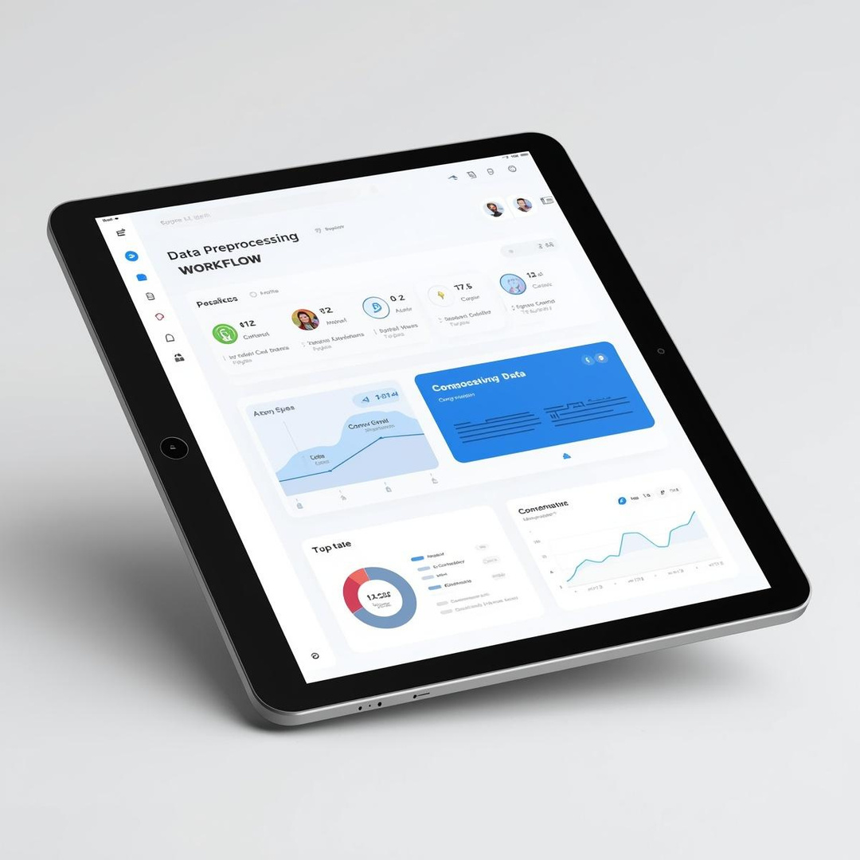
📊 Under Standing the Data
Dataset • Preprocessing • Modeling
Data Preprocessing
Transforming raw behavioral data into reliable analytics:
LOAD DATA 📂
Imported behavioral dataset using Python (Pandas)
df = pd.read_excel("file.xlsx")
Inspect Data🔍
Reviewed structure, distributions, and missing values
df.info() ,df.describe()
CLEAN DATA 🧹
Removed duplicates
Handled missing values
Improved consistency
df = df.drop_duplicates() df = df.fillna(0)
Validate Data✅
Date → datetime
Numeric → int/float
Categories → text
Notes:
Data Preprocessing
Transforming raw behavioral data into reliable analytics:
1- Data Cleaning steps:
Loaded data from multiple sources.
Removed duplicate and unnecessary columns.
Handled missing values.
Formatted date and numerical fields.
Created calculated columns for analysis
Standardized date and time formats.
2- Data modeling for power bi steps:
Created new calculated fields using DAX
Created relation between tables

Slide 10
📊 Under Standing the Data
Dataset • Preprocessing • Modeling
Data Preprocessing
Transforming raw behavioral data into reliable analytics:
1- Data Cleaning steps:
Loaded data.
Removed duplicate and unnecessary columns.
Handled missing values.
Formatted date and numerical fields.
Created calculated columns for analysis
Standardized date and time formats.
2- Data modeling for power bi steps:
Created new calculated fields using DAX
Created relation between tables

Slide 11
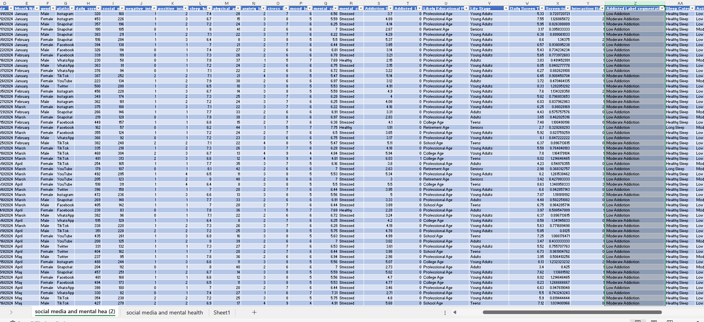
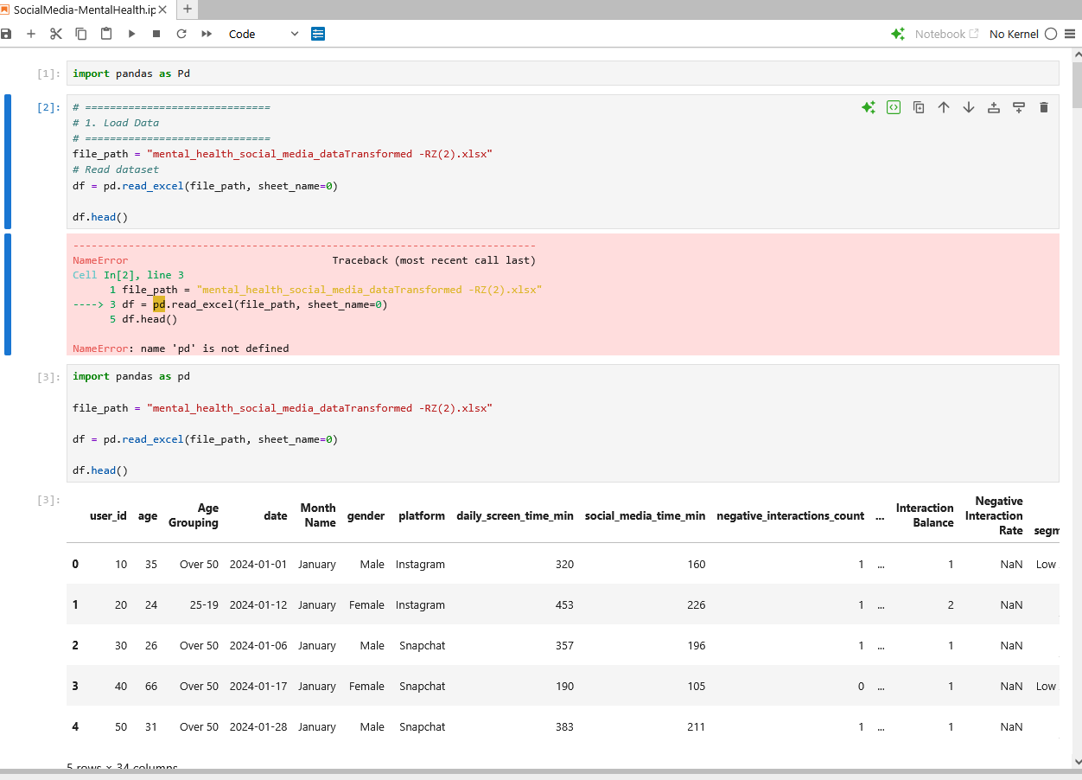
📊 Under Standing the Data
Dataset • Preprocessing • Modeling
1- Data Cleaning
2- Table Cutting
3- Create Column by power Query
4- Create Measures
5- Creating relations

Slide 12
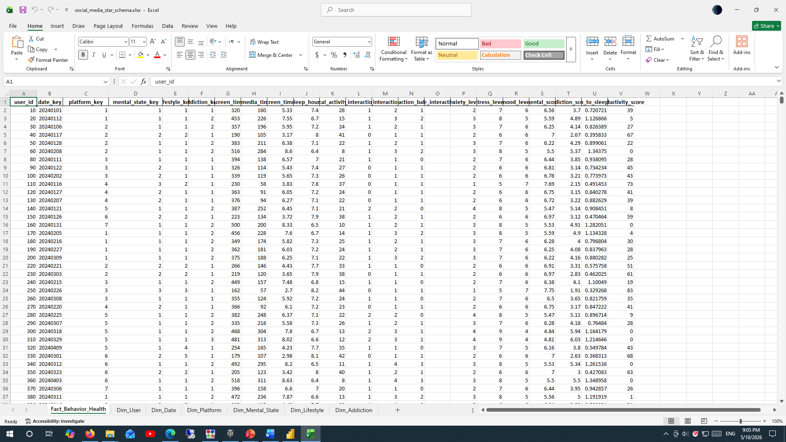
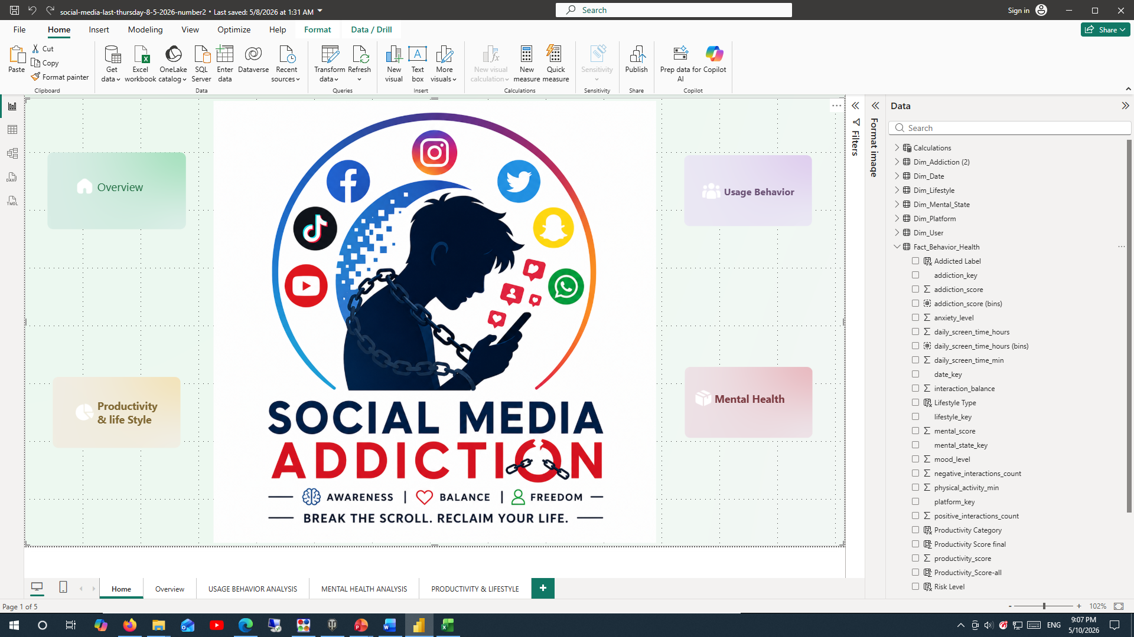
📊 Under Standing the Data
Dataset • Preprocessing • Modeling
1- Data Cleaning
2- Table Cutting
3- Create Column by power Query
4- Create Measures
5- Creating relations

Slide 13
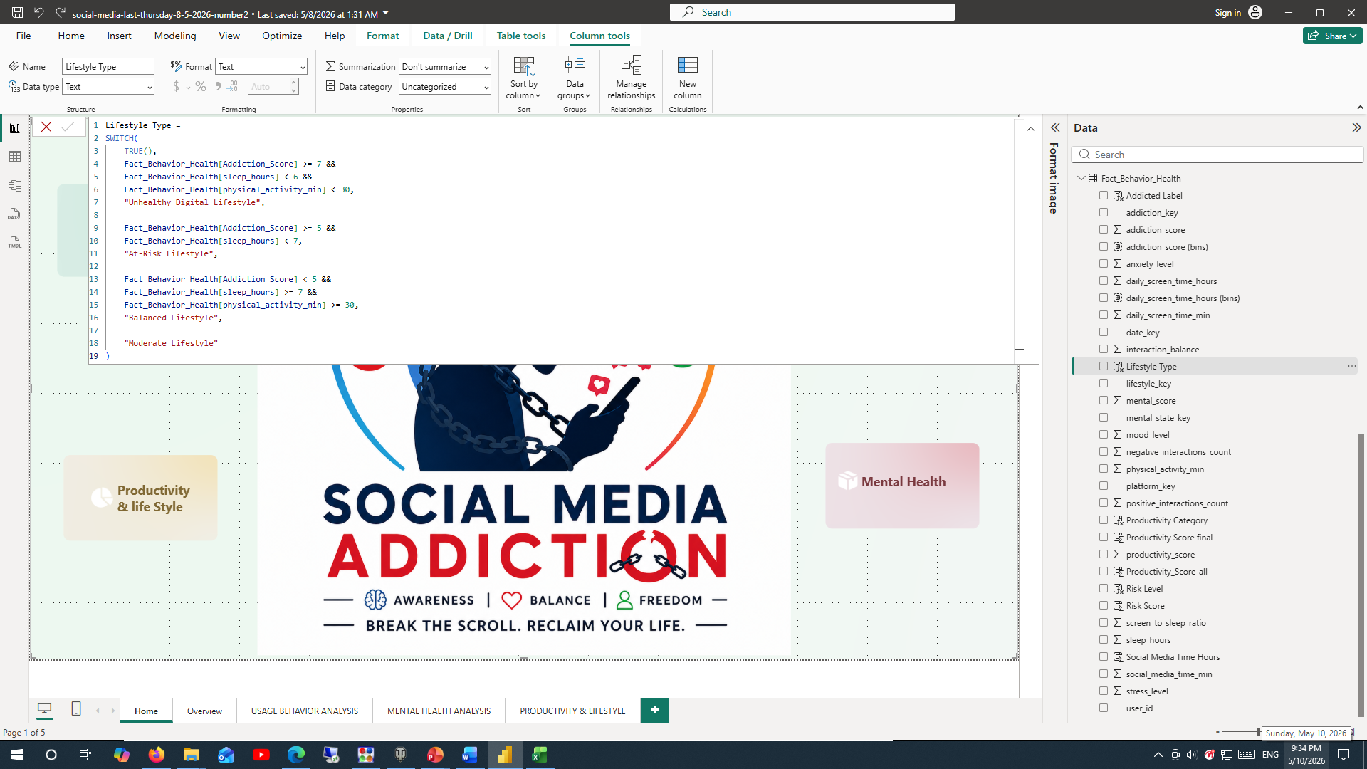
📊 Under Standing the Data
Dataset • Preprocessing • Modeling
1- Data Cleaning
2- Table Cutting
3- Create calculated Columns
4- Create Measures
5- Creating relations

Slide 14
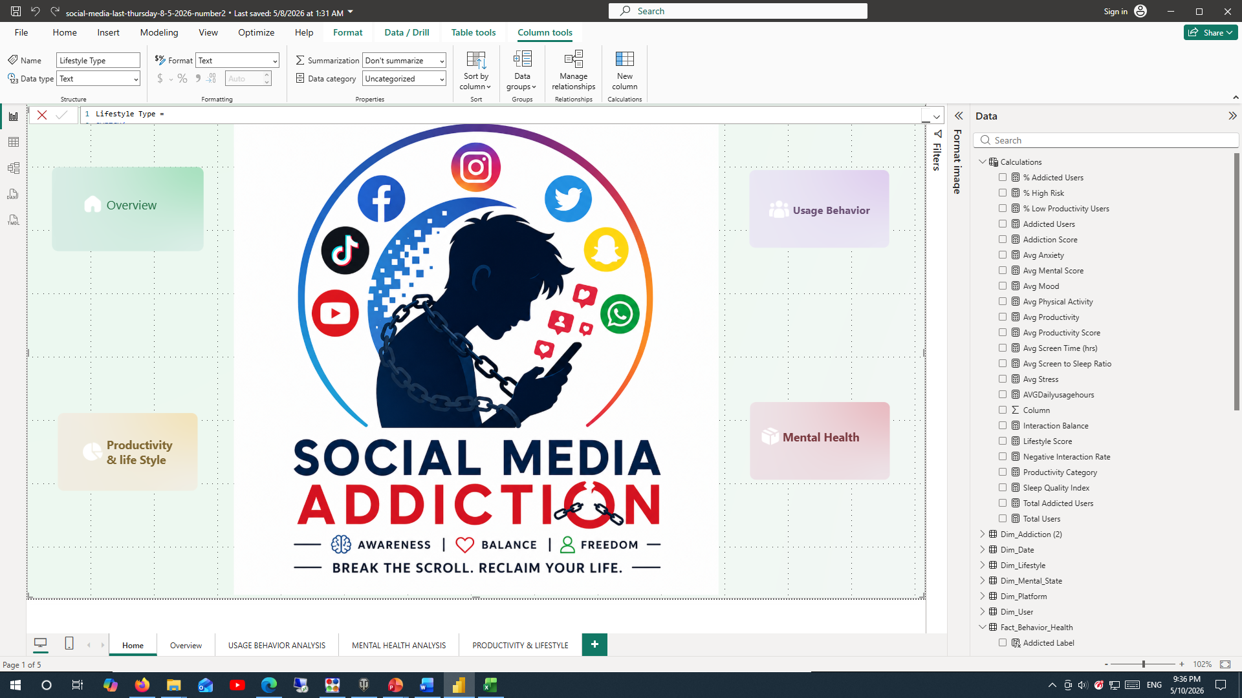
📊 Under Standing the Data
Dataset • Preprocessing • Modeling
1- Data Cleaning
2- Table Cutting
3- Create Column by power Query
4- Create Measures
5- Creating relations

Slide 15
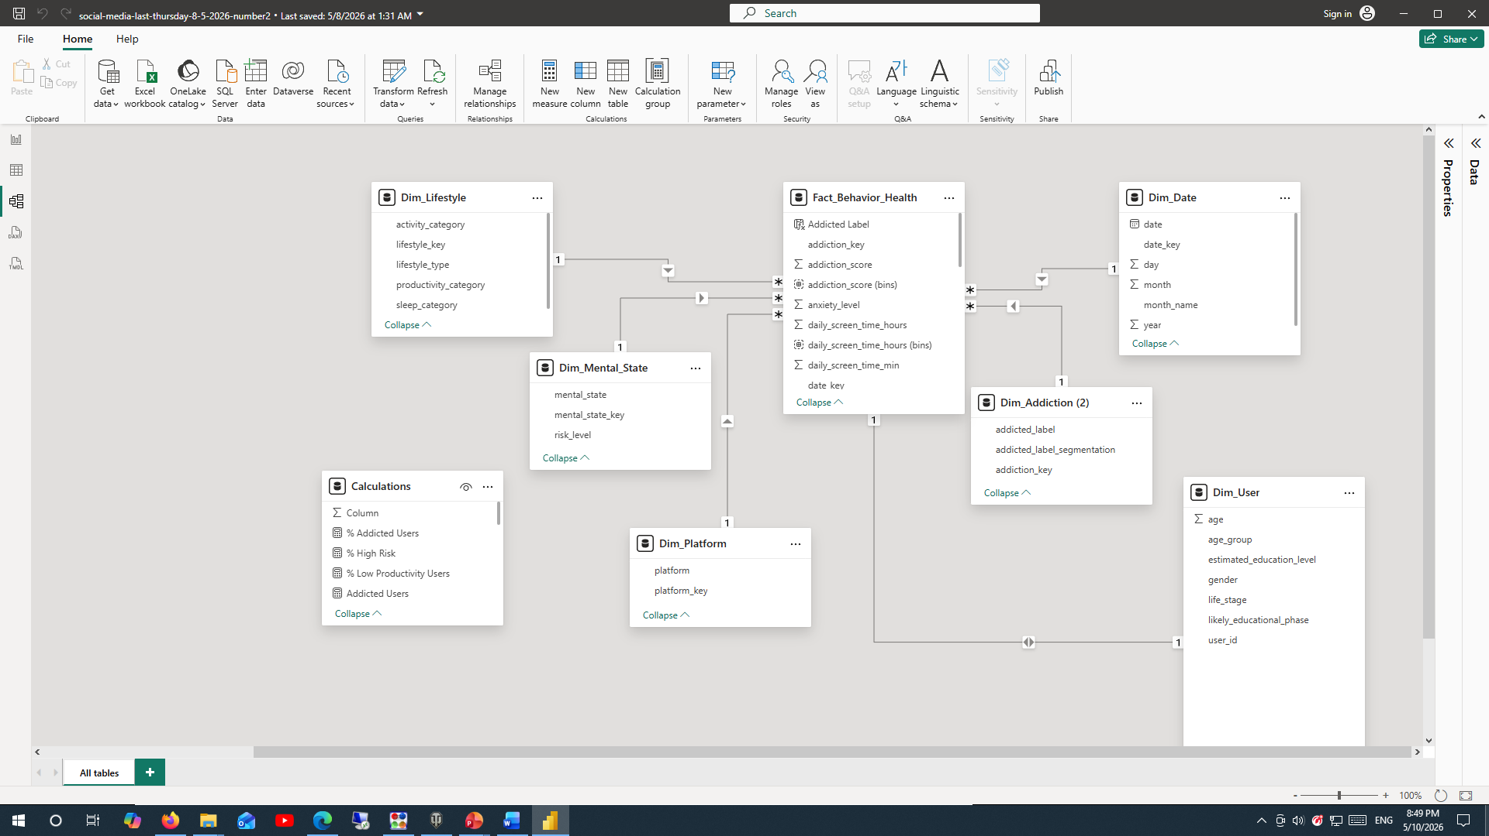
📊 Under Standing the Data
Dataset • Preprocessing • Modeling
1- Data Cleaning
2- Table Cutting
3- Create Column by power Query
4- Create Measures
5- Creating relations

Slide 16
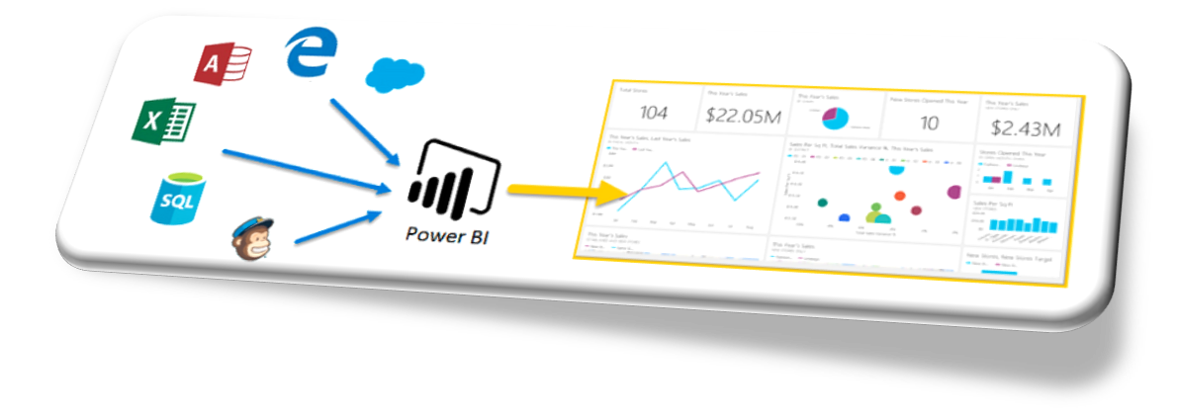
📊 Under Standing the Data
Dataset • Preprocessing • Modeling
Visuals :
Line Charts – Showed ridership trends over time.
Bar Charts.
KPI Cards – Highlighted key statistics.
Pie charts.
Slicers.
Multicard

Slide 17
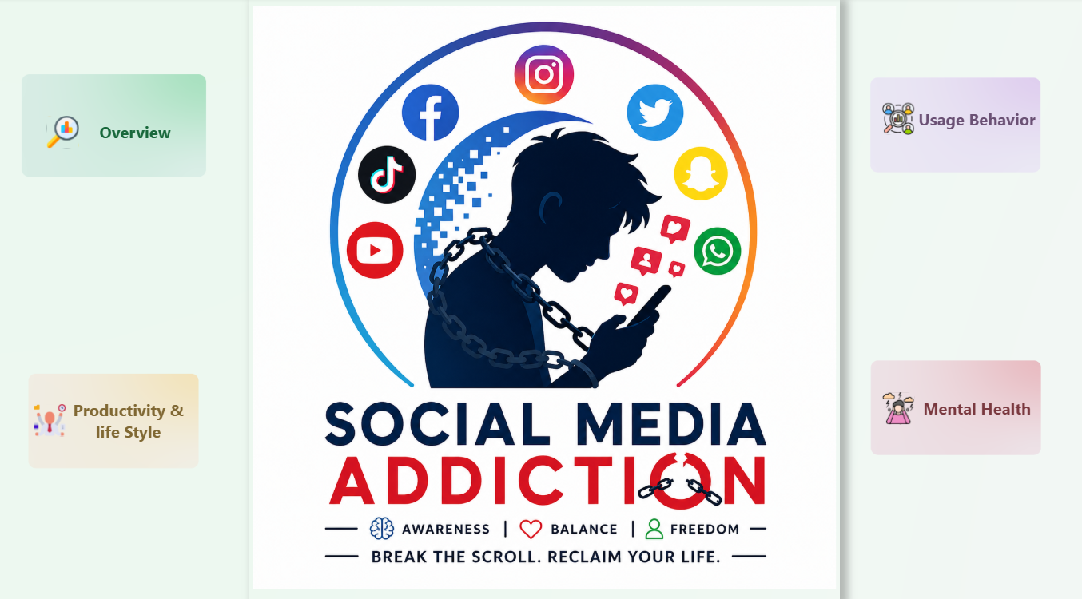
🧠 Project Building
Usage • Mental Health • Productivity
Home Page
1

Slide 18
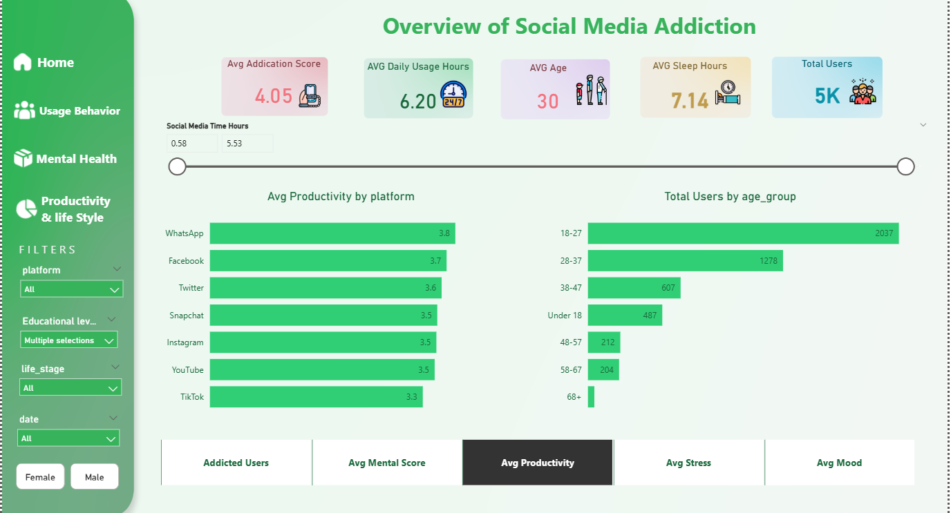
🧠 Project Building
Usage • Mental Health • Productivity
Overview

Slide 19
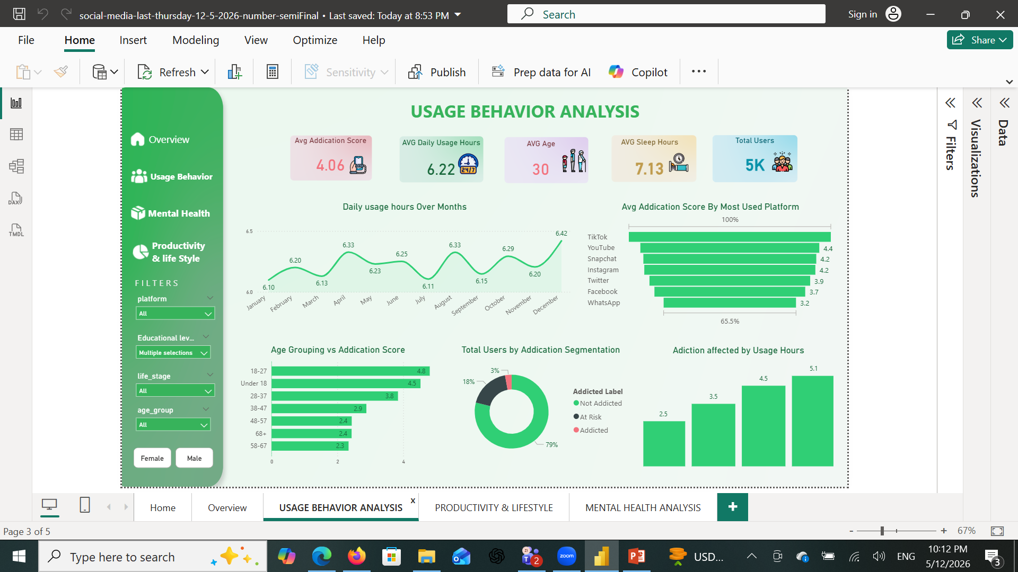
🧠 Project Building
Usage • Mental Health • Productivity
Usage Behavior Analysis:
1

Slide 20
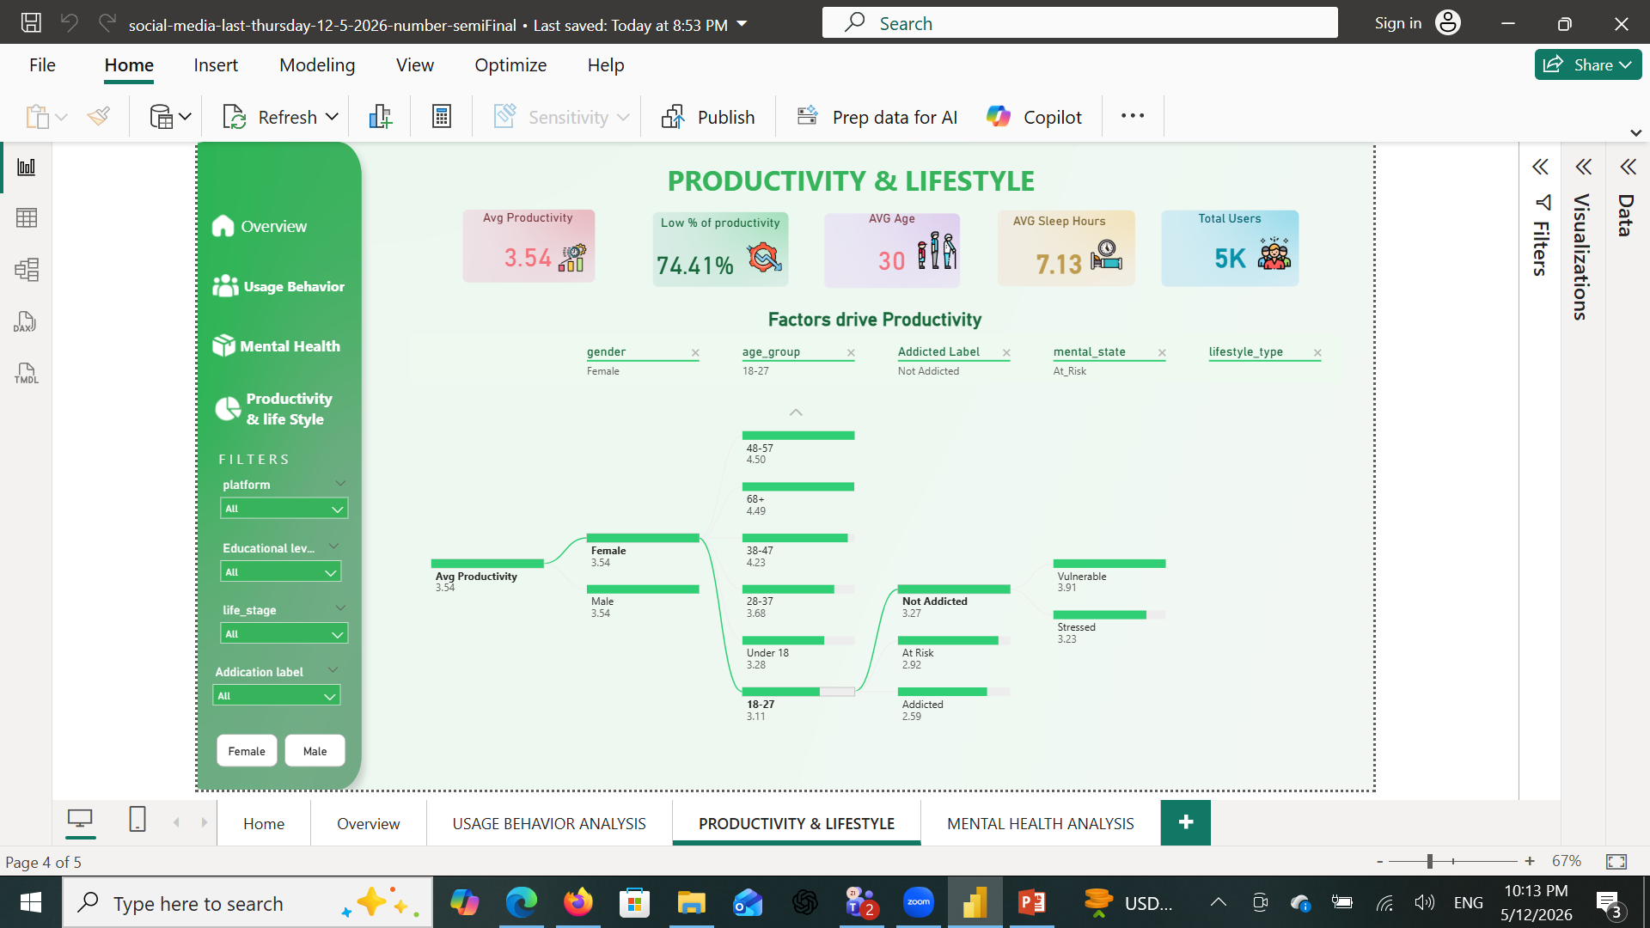
🧠 Project Building
Usage • Mental Health • Productivity
Productivity & Lifestyle
1

Slide 21
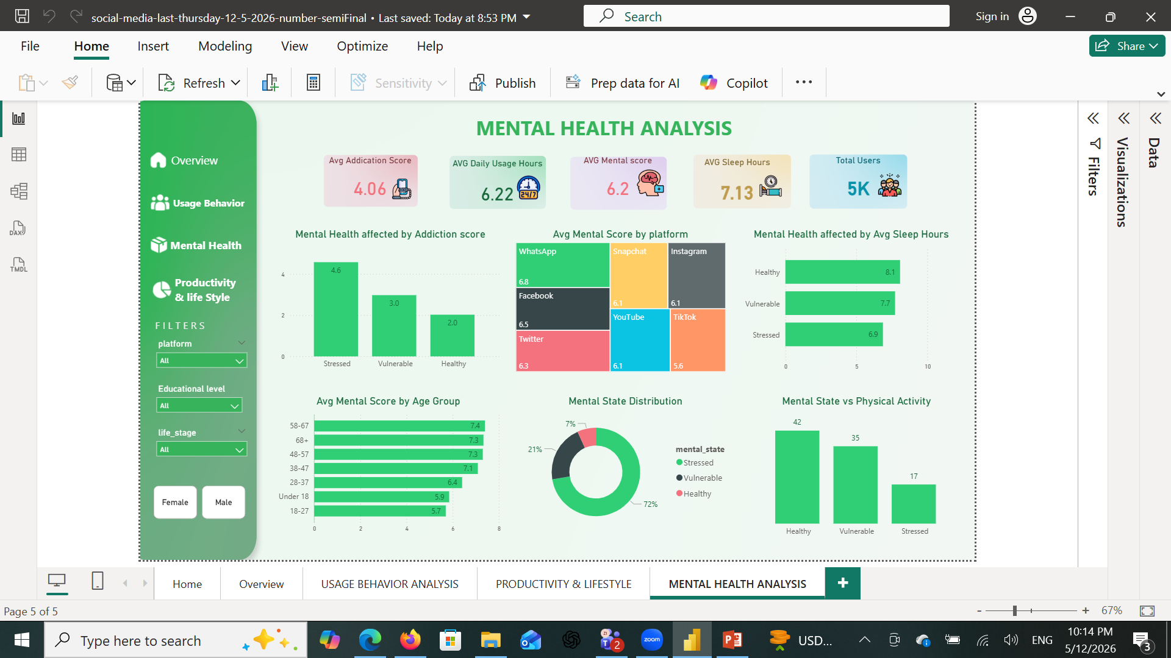
🧠 Project Building
Usage • Mental Health • Productivity
Mental Health Analysis
1

Slide 22
🔥 FINAL INSIGHT (VERY IMPORTANT)
👉 Each column plays a role:
Usage Data → Explains Behavior Mental Data → Explains Impact Productivity Data → Explains Outcome
👉 Addiction ↑ → Productivity ↓ → Mental Health ↓

Slide 23
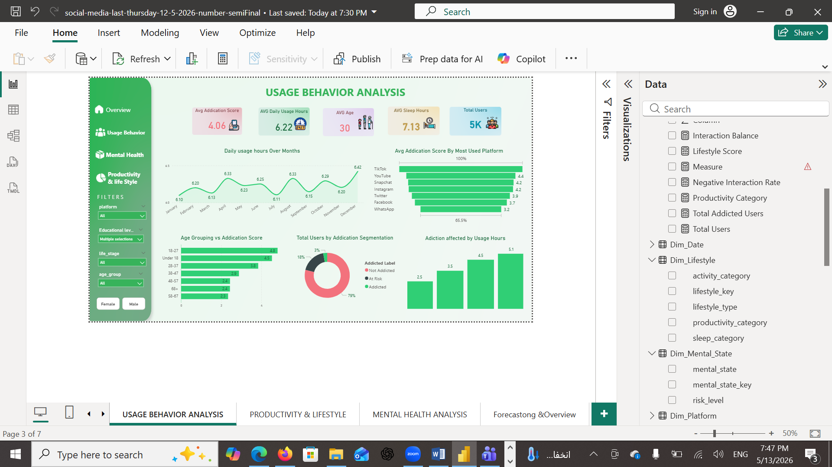
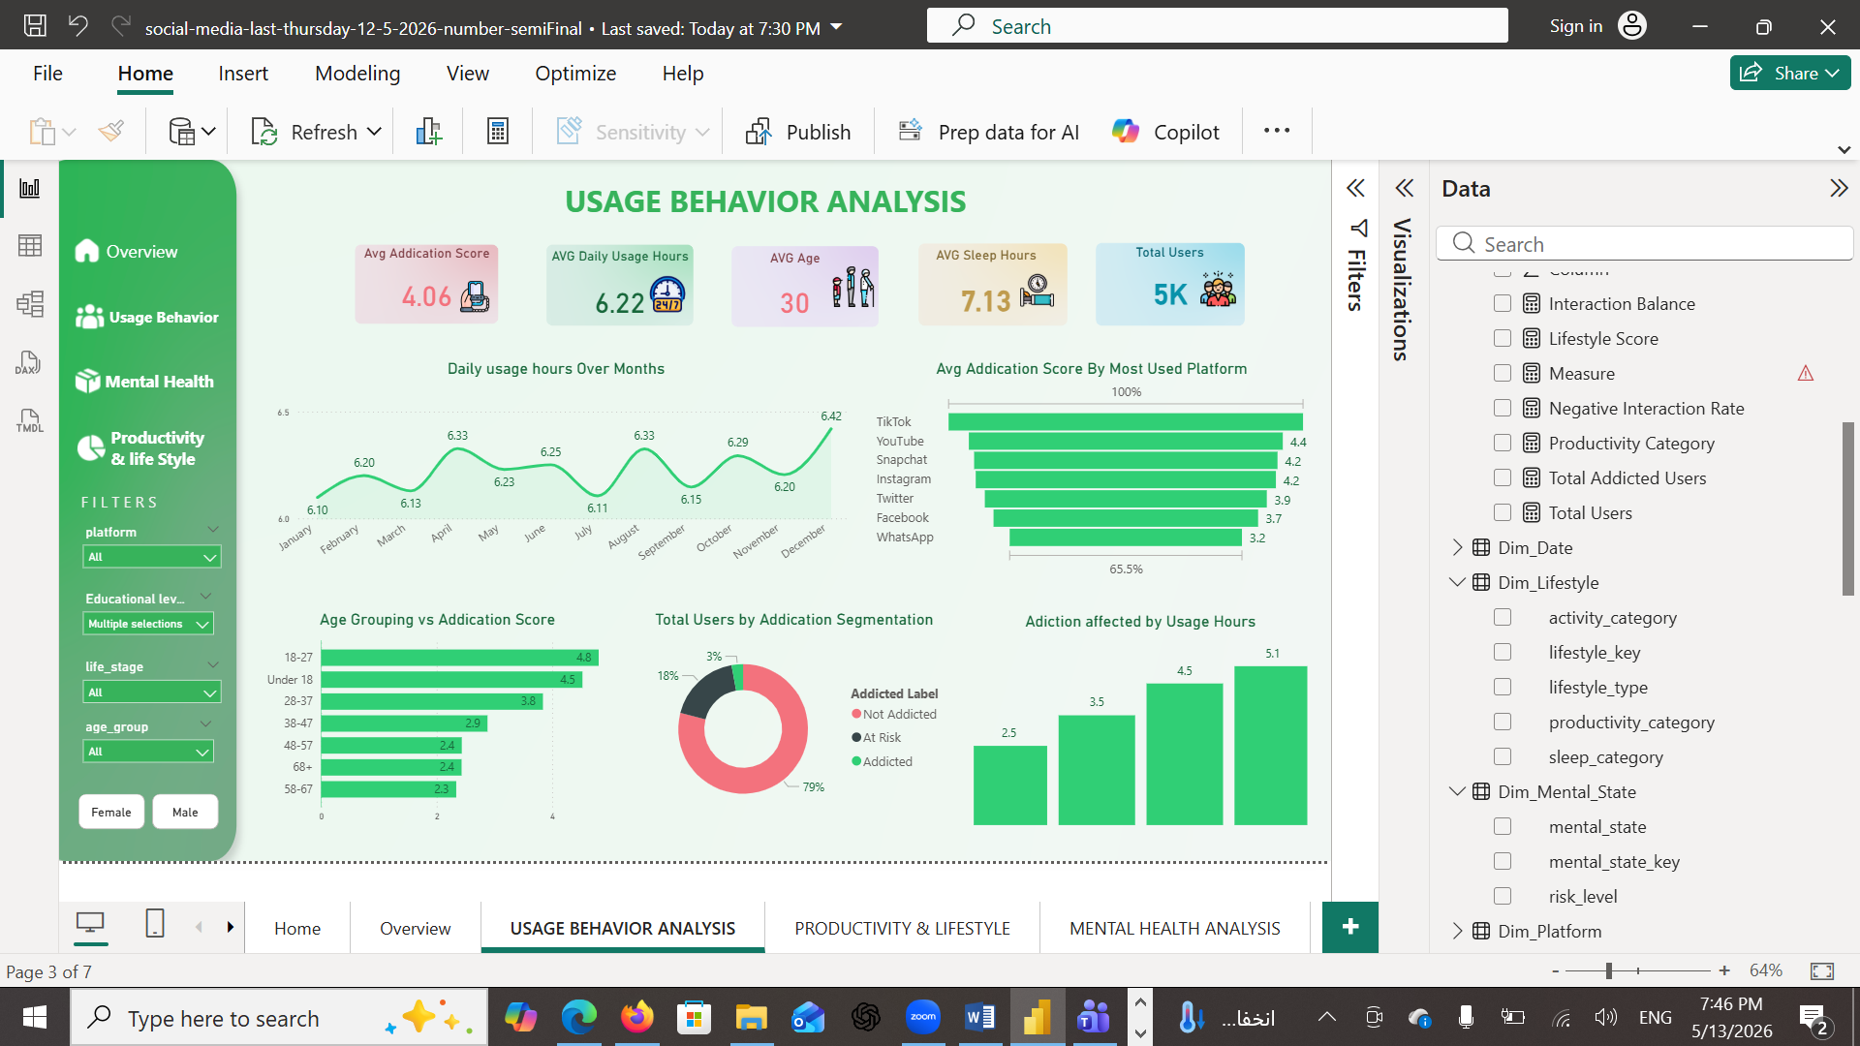
🔥 KEY Insights & Analytical Findings
Behavioral Insights
Higher screen time strongly correlates with higher addiction
High social media ratio is the strongest indicator of addiction
Certain platforms drive higher engagement and dependency

Slide 24
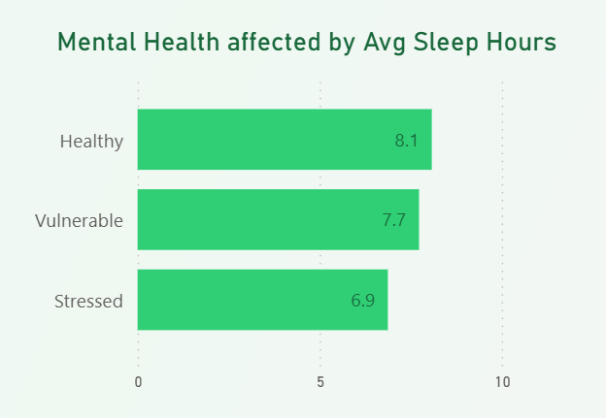
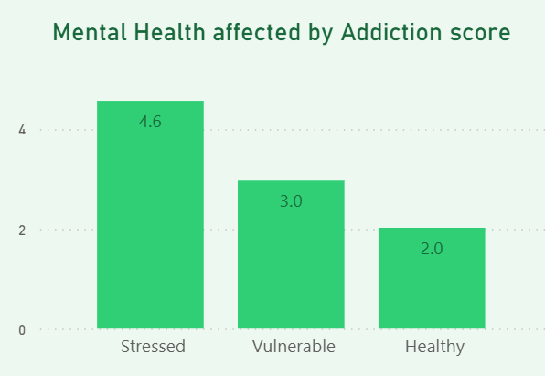
🔥 KEY Insights & Analytical Findings
Addiction patterns • High-risk users
Mental Health Insights
Increased addiction → higher stress and anxiety
Negative interactions significantly reduce mood levels
Sleep has a strong positive effect on mental health

Slide 25
🔥 KEY Insights & Analytical Findings
Addiction patterns • High-risk users
Mental Health Insights
Increased addiction leads to :
higher stress
higher anxiety
lower mood levels
Sleep quality improves mental health stability

Slide 26
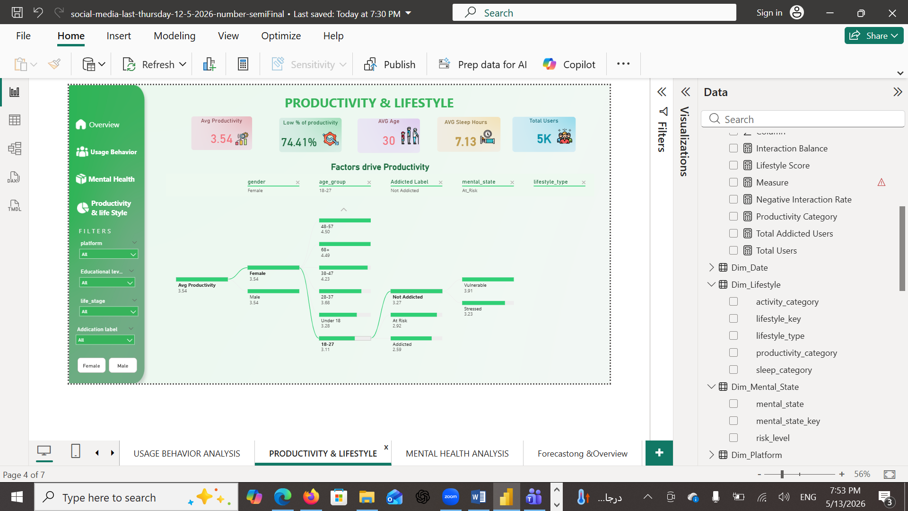
🔥 KEY Insights & Analytical Findings
Addiction patterns • High-risk users
💼 Productivity Insights
Addiction leads to lower productivity scores
High screen time reduces focus and efficiency
Sleep and physical activity are the strongest productivity boosters
High stress amplifies productivity loss

Slide 27
🔥 Recommendations
👤 Individual
Limit screen time (< 4 hours/day)
Limit screen time to < 4 hours/day
Maintain 7–8 hours of sleep
Reduce exposure to negative interactions
Schedule offline activities

Slide 28
🔥 Recommendations
🏢 Organizational
Monitor employee screen usage patterns
Introduce digital wellbeing programs
Provide access to mental health support

Slide 29
🔥 Recommendations
📱 Platform
Add usage alerts and limits
Provide weekly behavior reports
Reduce exposure to harmful content

Slide 30
🔥 Recommendations
🔥 Strategic Insight
👉 👉 Focus on users with:
Social Media Ratio > 70%
High addiction score
✔ These are high-risk users

Slide 31
🔥 Recommendations
2hrs
8hrs
30 min
1hr
DAILY LIMIT
SLEEP HYGIENE
BREAKS
OFFLINE TIME
Set a maximum 2-hour daily limit for social media usage.
Ensure 8 hours of sleep by avoiding screens 1 hour before bedtime.
Take 30-minute breaks between social media sessions.
Dedicate 1 hour daily to offline activities and hobbies.

Slide 32
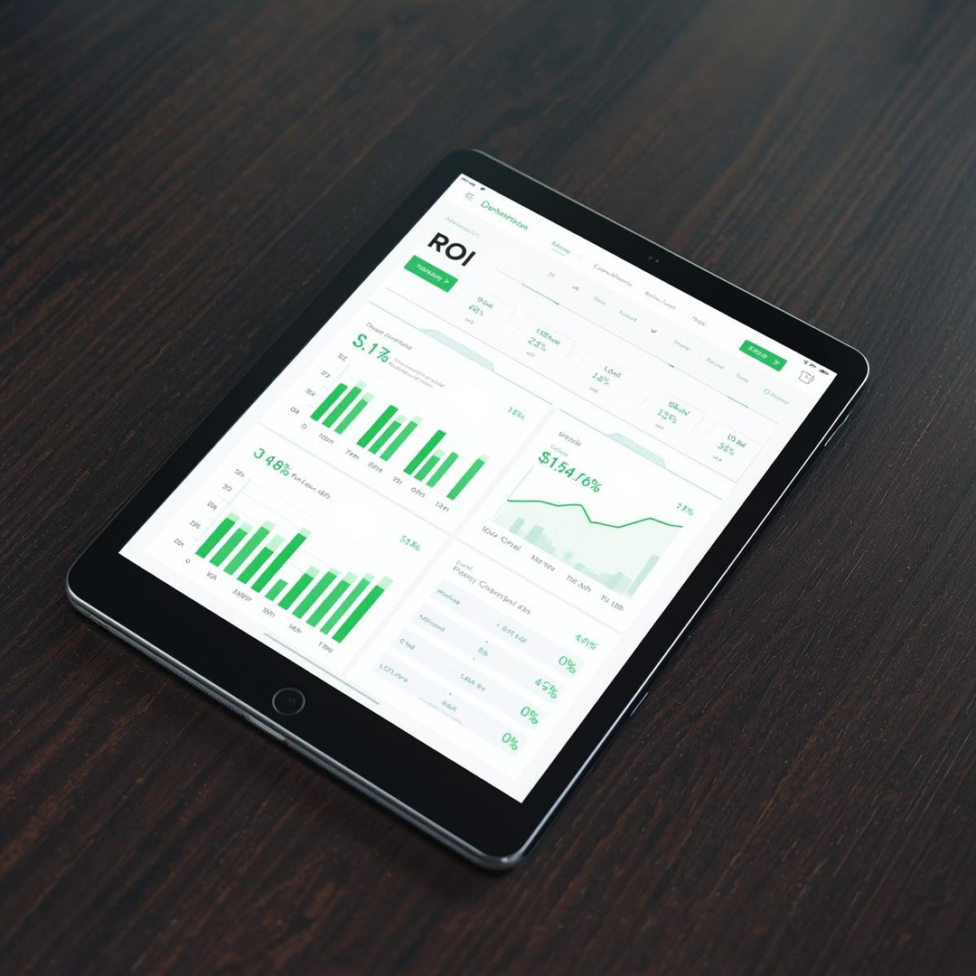
🔥 Business Value
🔹 Value Delivered
✔ Early detection of addiction risk ✔ Improved mental health awareness ✔ Increased productivity optimization ✔ Behavioral segmentation for decision-making ✔ Support for data-driven policies

Slide 33
🔥 Business Value
🔹 Organizational Impact
Helps HR and management understand employee behavior
Supports wellness initiatives
Enables predictive planning

Slide 34
🔥 Business Value
🔹 Organizational Impact
Helps HR and management understand employee behavior
Supports wellness initiatives
Enables predictive planning

Slide 35
🔥 CONCLUSIONS
Social media addiction is not only a usage problem
It is a behavioral, mental health, and productivity challenge
This project provides a data-driven framework to:
detect addiction early
improve mental health awareness
optimize productivity
support strategic decision-making

Slide 36
Acknowledgement
We would like to express our sincere gratitude to DEPI for managing and presenting these valuable courses, providing us with an excellent learning experience.
A special thanks to YAt for their support in providing skilled instructors who have guided us throughout the training.
Most importantly, We extend our deepest appreciation to Instructor Mahmoud Emad for his dedication, expertise, and insightful teaching, which have significantly enriched our knowledge. Your efforts are truly appreciated, and we are grateful for this opportunity to learn and grow. Thank you!

Slide 37


Thank You

